Slide 1
COMP-1295 Information Systems
Hardware #4 > System Components >
Memory & Storage

Slide 2
Memory & Storage > Objectives
Topic objectives:
Interpreting storage/memory capabilities and how they work
Learning about the various types of short, long, and “permanent” storage
Understanding the memory hierarchy that make up a system’s memory
Understanding what constitutes volatile & non-volatile memory/storage
Types of Volatile Memory used in modern systems

Slide 3
Memory & Storage
System memory and storage can be imagined as a:
Cupboard’s various sized shelves containing glasses which are either full OR empty of water
…or in computer speak, a:
System’s various sized memory/storage devices with several Memory Cells either filled with bit/binary data 0 or 1 OR NULL/Not Set
…where, the old adage of optimism (glass is half full) or pessimism (glass is half empty) does not apply. It’s always full or empty, there is no in-between.

Slide 4
Memory & Storage
Each of these glasses (memory cells) are “sequentially filled” to either full (0 or 1) or empty (NULL or Not Set yet), there is no in-between. Some of these shelves or shelves’ glasses can be:
Only filled once and for the most part, fill-only (read-only)
Regularly filled/unfilled when the water starts running or emptied when shutoff (loading/unloading system hardware, OS, services during startup/shutdown)
Unpacked and sectioned from one another (partitioning, formatting)
Filled by a higher power and unfilled when completed or if manually emptied (cloud, background services, viruses)
Filled by yourselves and unfilled when completed (load/unloading apps/programs)
Filled and stay that way for the shorter-to-longer terms (file management)
Be reorganized so the glasses are sequentially filled “back” from the start (defragmentation)
Dying/dead, due to manufacturing errors OR the age of cupboard, shelf, or glass breaks (cell/sector/hardware failures)

Slide 5
Memory & Storage > Common Terms
Storage hardwares has 3 commonly used terms:
ROM (Read-only Memory):
typically permanent storage areas
stores hardware device configurations and unaccessible/unwritable areas of memory (BIOS, UEFI)
RAM (Random-access memory) or termed as just Memory:
short term active storage that can quite easily dictate how a system will perform (too little, slow…too much, there’s never really too much)
sequentially fills up during startup and when loading apps/programs/services
Hard Disks/Drives :
longer termed rewritable (RW) storage
contains source files of installed programs and the files/folders users’ manage
can also be used to hold overages from RAM into virtual memory or swap files/disks
…and can be imagined as separate shelves.

Slide 6
Memory & Storage > Memory Types
Systems’ storage/memory were designed with the following characteristics:
Termed > Short, long, mostly “permanent” terms
Accessibility > Machine-only or machine/user
Power > Constant power, otherwise storage will reset (empty)
Permissions > R (Read-only) or W (Write-only) or > R/W (Read OR Write) or RW (Read & Write)
Notes:
What storage or memory device, that I mentioned on the Previous Slide

Slide 7
Memory & Storage > Memory Types
Storage/Memory is broken up into 2 fundamental types:
Volatile Memory (most common device is RAM):
Termed > Short term/primary storage
Accessibility > Machine-only accessible (indirectly by the user)
Power > Must have constant power, or it resets/empties
Permissions > RW type storing active/loaded OS/App/HW data
HW Devices > RAM, Video RAM, CPU Cache, CPU Registers, HDD/SSD Disc Cache
Non-Volatile Memory:
Termed: > Longer term/secondary storage
Accessibility: > Machine-only AND User/Machine accessible
Power: > Does not require power to retain OS/app data
Permissions: > R/W types storing running OS/App/HW data > RW types storing OS/App/Temp/Users’ files/folders

Slide 8
Memory & Storage > Memory Types
Non-Volatile Memory: (continued)
HW Devices:
ROM (Read-Only Memory) - hard-wired or “permanent” devices storing software w/data known as firmware BIOS/UEFI and CMOS Settings chip and while “can” though it “rarely” gets emptied. Here are ROM versions’ progression:
Programmable (PROM)
Erasable (EPROM)
Electrically (EEPROM)
Electrically Alterable (EAPROM)
Optical Media - CD, DVD, BD ROM drives
Magnetic Disks - Hard Disk, 3½-5¼ Floppy, Tape drives
Solid State - SSD drives, Flash memory (based on EEPROM)

Slide 9
Memory & Storage > Hierarchy
Systems’ Memory Hierarchy
Power
Term
Speed
Capacity
Size
Price
CPU Registers (R0, R1, …R#)
Immediate
Very Expensive
Internal
Very Fast
Small
Small
CPU Cache (L1, L2, … L#)
On
Very
Short
Fast
Medium
Medium
Afford
-able
Main Memory
RAM / Virtual Memory
/ Controller Cards
Online Mass
& Secondary Storage
ROM / BIOS-UEFI USB/Flash Memory
Short
Slower
Large
Small
Cheap
HDD / SSD / Network
Internet Storage
Off
Mid
Slow
Very Cheap
Very Large
Large
Offline Bulk &
Tertiary Storage
Tape Backup
Units
Long
Very
Slow
Afford
-able
Tape Backup

Slide 10
Memory & Storage > CPU Registers
CPU Registers’ are:
Non-Volatile, of small size and very fast
Embedded into each CPU core
Read-only or Write-only characteristics
Employ very specific CPU functions and are not related to Hardware Registers, but act very similar
Variants of the number, type, and size of the registers are directly tied into the processor you would buy
Not typically a factor when buying one

Slide 11
Memory & Storage > CPU Registers
CPU Registers have specific functionalities, classified as:
User-accessible > externally accessed/RW by machine instructions:
Data formats > Data (Accumulator), Status, Constant, Floating-Point (FPRs), Vector
Control/Location > Address (stack pointer), Memory Type Range (MTRRs), General-purpose (GPRs) > registered as R0, R1, R2, … R#
Special-purpose (SPRs) > holding program states, such as Program Counter (PC) or Program Status Word (PSW, combined PC w/Status register)
Internal - RW, internally accessed/RW (non-machine) CPU instructions:
Instruction (IR) > real-time executing processes
Memory Buffer/Data (MBR/MDR) > fetchers of data from RAM
Memory Address (MAR) > RW locational storage for memory addresses
Architectural > accessible by software defined by the architecture
Register Renaming > when/if present, shifting logical-to-physical registers, then the architecture’s defined software will not correspond to physical hardware

Slide 12
Memory & Storage > CPU Cache
CPU Cache Memory is:
a small and fast, CPU-embedded cache for frequently used data in and out of CPU Registers
CPUs can have ordered multi-level caches
starts at L1, L2, …to L#, where # is the number of levels
L1 is the smallest and fastest and incrementally each L# is bigger and slower, but not as slow as retrieving from RAM
CPU will determine what level the memory block should be held in based on frequency of use
If the memory block is frequently used, it will stay in a higher cache level (L1 perhaps), otherwise it will get demoted a level or further levels, or subsequently into RAM
the Cache Performance formula, Cache Hit Ratio, calculates as:
Note: CPU cache tuning methods are beyond the scope of this course
Cache_Hit_Ratio = Cache_Hit / ( Cache_Hit + Cache_Miss )

Slide 13
Memory & Storage > RAM (Memory)
Random Access Memory (RAM):
vacuum tubes (in older TVs and CRT displays) were the first type of RAM, until the MOSFET transistor was invented by (Bell Labs)
critical to a machine’s overall performance and life-expectancy, as important as the CPU and Drives
loaded with active data/configurations and processed instructions from the CPU, OS and Services’ apps, and loaded third-party startup/user-loaded apps
motherboards have limitations with regards to RAM support:
2 to 4 RAM expansion slots (some even up to 8 slots)
many use dual channel: 2 sticks installed/working together
some are single channel: can have just 1 stick
support up to a certain gigabyte (GB) size of RAM:
commonly 8-32GB are typically installed on off-the-shelf systems
upgrades to 64 or 128GB are possible, if the motherboard supports it
…and there are various other RAM-to-Motherboard supports/specs

Slide 14
Memory & Storage > RAM Types
Historical/Current types of RAM > updates:
DRAM (Dynamic RAM) > 1970s thru mid-1990s:
smaller, compact, cheaper, larger storage size yet slower
circuit config was a 1:1 transistor-capacitor memory cell
required asynchronous (immediate) refreshing (10-100ms) for capacitors to keep charge
SRAM (Static RAM) > 1990s & onward:
fastest, expensive, constant power flow, so no refreshing required, and used for CPU Cache, Hard drive buffer/cache, DACs (digital-to-analog converters in video cards),
permanent fixed config of 6 CMOS transistors to store a bit, dubbed a flip-flop
Note: These lead to memory latency calculations for the memory data request and delivery time by determining the # of CPU clock cycles it took for RAM data to get passed over to the CPU for processing

Slide 15
Memory & Storage > RAM Types
Historical types of RAM and updates: (continued)
SDRAM (Synchronous DRAM) > 1993 & onward:
performs higher CPU transaction rates with processes executing 1 RW instruction per CPU Clock Cycle (RW/CPU-CC) and waits for that clock signal before UI/data response begins
synchronous operations that can R new instructions before the previous W is complete, so instructions can be overlapped simultaneously, in parallel, referred to as “pipelining”
pipelining is made possible by the separate banks integrated within SDRAM stick
SDR (Single Data Rate) SDRAM > 2000 & onward:
specs: Same as SDRAM, simply flags the 1 RW/CPU-CC, 168 pins, @ 3.3V
DDR (Double Data Rate) SDRAM > 2000 & onward:
specs: the dual has 2 RW/CPU-CC, 184 pins, less voltage @ 2.5V, clock speed 200MHz max
not backwards or forward compatible other *DR# SDRAM

Slide 16
Memory & Storage > RAM Types
Historical types of RAM and updates: (continued)
DDR2 SDRAM > again has 2 RW/CPU-CC, differs with higher speed up to 533MHz and lower voltage @ 1.8V, 240 pins
DDR3 SDRAM > reliability w/advanced signal processing, high memory capacity and a speed bump to 800MHz, voltage drop @ 1.5V, 240 pins
DDR4 SDRAM > another reliability bump w/advanced signal processing, higher memory capacity, 1.6GHz, 1.2V, 288 pins
DDR Version notes: with transfer rates are at the core of the updates
growing clock speeds (MHz to GHz)
lower power consumption (voltage)
no iteration of DDR is backward or forward compatible
DDR3 introduced reliability advances w/advanced signal processing
memory sizes don’t change much 2GB to 128GB
generally DDR4 is better than DDR3 is better than DDR…etc.

Slide 17
Memory & Storage > RAM Specs.
Other RAM specifications will vary based on motherboard chosen:
ECC (Error Correcting Code) memory which can detect/correct errors (performs 2-3% slower than non-ECC) and found on servers/higher-end workstations (ECC RAM $$$, ECC RAM supported Motherboard $$$)
Registered/Buffered memory allows more stability and larger memory loads, than Unbuffered Memory (Buffered RAM $$$, Buffered RAM supported Motherboard $$$)
DIMM (Dual In-line Memory Modules) also designed for servers and workstations, have a 64-bit data path and…
As compared to its predecessor SIMM (Single), which had 32-bit paths and was matched in pairs and accessed in parallel

Slide 18
Memory & Storage > RAM > Channels
Motherboard Memory(RAM) Channels:
Single Channel > moves 64-bit data from a single stick of RAM down the memory bus path to the CPU
Dual Channel > moves 2 (sticks of RAM) × 64-bit data for a total of 128-bit channel down the mem bus to the CPU
Multi-channel Memory Architecture > refers to the increase in memory channels to improve data (transfer) rates and lower memory latencies for the DRAM & SDRAM memory and its controller

Slide 19
Memory & Storage > Virtual Memory
Virtual Memory is a method of using disk space for memory and is used when opening apps into dedicated physical location(s) by a system’s Memory Management Unit (MMU) which:
virtually assigns where the apps’ required memory is to be stored
ensures another opened app will not overwrite the previous opened apps
relatively assigns, for the virtual memory block, where memory needs to be allocated to:
if there is space in main memory (RAM), then stored to RAM
else it is stored to physical memory in a swap file

Slide 20
Memory & Storage > Virtual Memory
Swapping is the MMU’s act of:
moving less used app memory blocks from RAM onto a physical hard drives, where locations may vary:
in Windows, the swap file is at C:\pagefile.sys (on the root)
in Linux, a swap partition or swapping-only dedicated hard drive called a swap disk/drive or scratch disk are configured
later when the block is needed, its is swapped back to RAM
therefore Virtual Memory is slower than RAM

Slide 21
Memory & Storage > Virtual Memory
Recommendations include:
only use swapping for installations or heavy processes that RAM cannot support and only increase size when necessary. Follow the operating system’s recommendations
avoid using a spinning HDD for swap as it is terribly slow, SSD on NVMe M.2 is favored if swapping is necessary. If you must use a hard disk for virtual memory, make sure the disk is not busy with other read/writes
app memory leaks can render systems unresponsive, if configured on a server, outcomes could be worse

Slide 22
Memory & Storage > RAID
RAID (Redundant Array of Independent Disks)
allows multiple disks to be grouped together into a single logical unit
operates on sectors, also termed Blocks
drives on a RAID can be configured to allow data to be written across multiple devices, called Striping
including duplicating data (called Mirroring) and creating:
Parity data, which is used to reconstruct lost blocks of data using what is left (on previous drives) along with the parity data

Slide 23
Memory & Storage > RAID Types
Hardware RAID > uses dedicated hardware to control a RAID array. The controller may be permanently attached to the motherboard, connected via an expansion slot, or be external.
Software RAID > uses a software controller implemented as part of the kernel

Slide 24
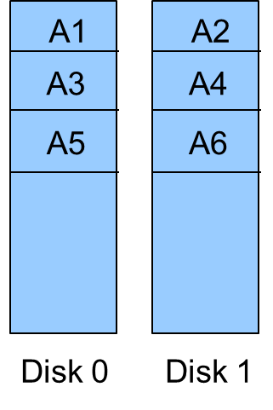
Memory & Storage > RAID 0
RAID 0 > Block Level Striping:
a method by which data is written successively across multiple disks, block by block
advantage of this method is faster retrieval of data
the drawback of this method is that there is no redundancy, and no error checking
a disk fails, you will need to go to the backups

Slide 25
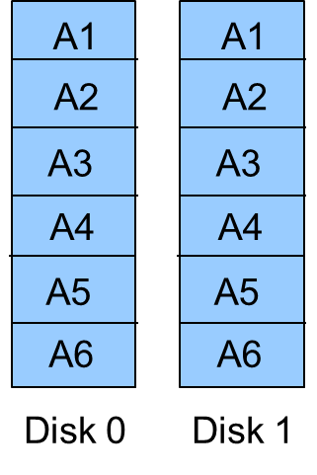
Memory & Storage > RAID 1
RAID 1 > Mirroring:
a copy of every block required by a file is installed on every disk in a mirrored array providing mirrored copies
does not increase performance
does not provide any error checking
if a disk goes down, the other disk can replicate once the downed disk is replaced
provides fault tolerance as two copies of the data are kept

Slide 26
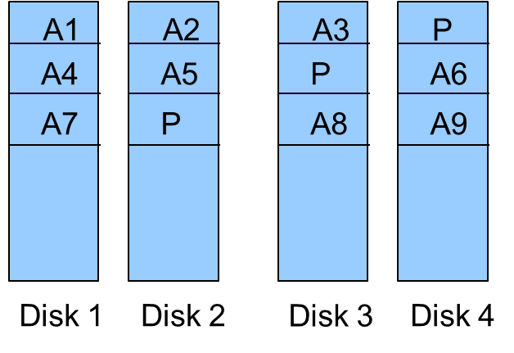
Memory & Storage > RAID 5
RAID 5 > Striping & Parity:
Stripes data across at least 3 drives, using parity information evenly distributed across the drives as well
if one disk fails, lost information can be rebuilt using the remaining information and Parity data
if two drives fail, cannot be restored, and you need to go to the backups

Slide 27
References
https://www.newegg.com/
https://en.wikipedia.org/
https://www.tomshardware.com/
https://www.techopedia.com/
https://www.pearsonitcertification.com/
https://www.memoryexpress.com/
https://www.geeksforgeeks.org/
https://www.pcmag.com/
https://talktechnical21.wordpress.com/
https://www.moddiy.com/
https://gamingcpus.com/
https://encyclopedia2.thefreedictionary.com/
https://turbofuture.com/
https://courses.lumenlearning.com/
https://www.sciencedirect.com/
https://csapp.cs.cmu.edu/
https://medium.com/
https://wccftech.com/
https://www.transcend-info.com/
https://smallbusiness.chron.com/
https://www.washingtonpost.com/
https://www.techspot.com/
https://computer.howstuffworks.com/
https://techpp.com/

Slide 28


